Slide 1
2024
Sinterstar Mini Specification

Slide 2
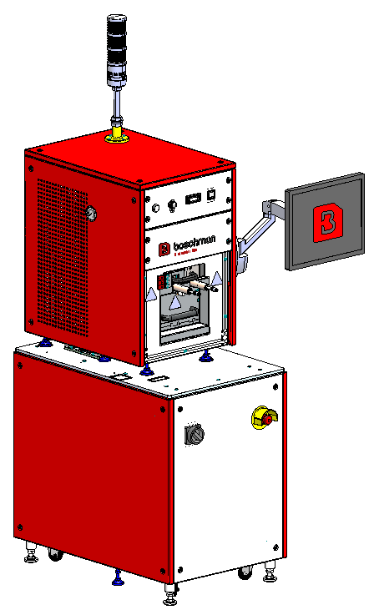
Sinterstar Mini
Designed for Universities, Laboratories, R&D departments and SME companies.
Easy to use
Ready for operation in 45 minutes.
Fast change-over; quickly run different process tests and products.
Wide variation of products can be sintered.

Slide 3
Sinterstar Mini
specifications
Effective sinter area: 66x66mm ,
Effective product area: 100x100mm
Product thickness range: 0,1-70mm
Sinter temperature up to: 280⁰C
Insert force range: 30N – 78kN
Programmable sinter pressure, time and temperature
Universal Base Tool set for one dynamic insert.
Color touchscreen / HMI
Advanced and precise process control with data export functionality
micro controlled environment
Vacuum controlled environment (optional) Easy product loading by means of drawer at the frontside

Slide 4
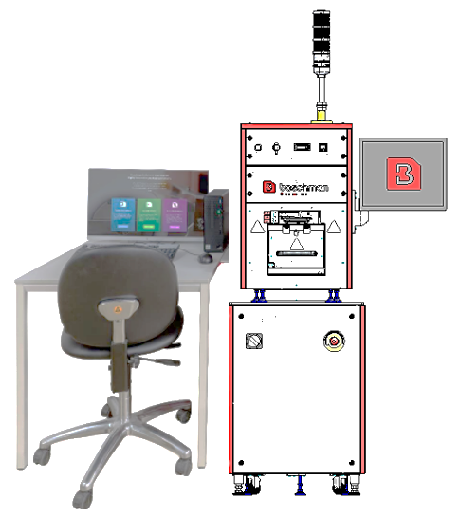
Sinterstar Mini
Main advantages dynamic insert technology
Our patented Dynamic Insert Technology provides maximum control and guarantees a uniform pressure.
The pressure can be varied easily via parameter setting on HMI.
Closed Loop process control; the insert pressure follows the programmed pressure.
The Universal Base Tool contains one dynamic insert
Minimal maintenance system

Slide 5
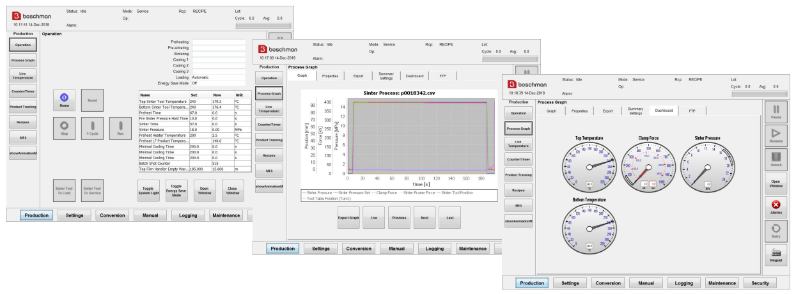
Sinterstar Mini
Dashboard with main process parameters and real time process graphs

Slide 6
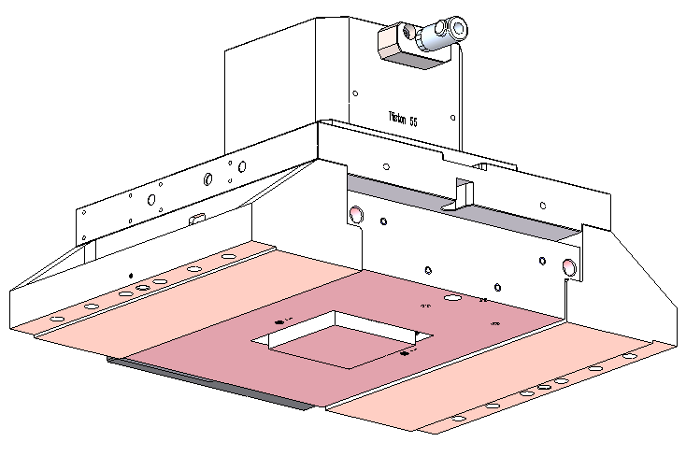
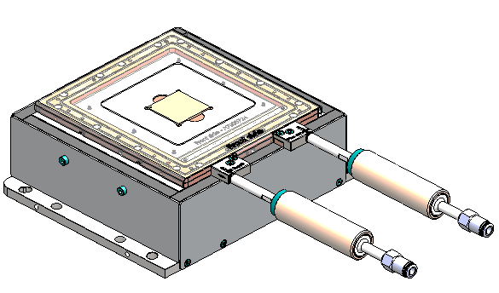
Sinterstar Mini
Universal Base Tool
This universal Base tool offers great flexibility and is perfect for Research and Quick prototyping purposes
For a unique product only dedicated inserts and alignment plates are required
These parts are easy and fast exchangeable
The universal Base Tool consists of:
Base top tool for 1 Dynamic Insert in a slide
Base bottom tool including loading jig with N2 supply
Product height conversion set from 0,01-70 mm
1x film roll, 50um thickness, 160 mm width, 100m length

Slide 7
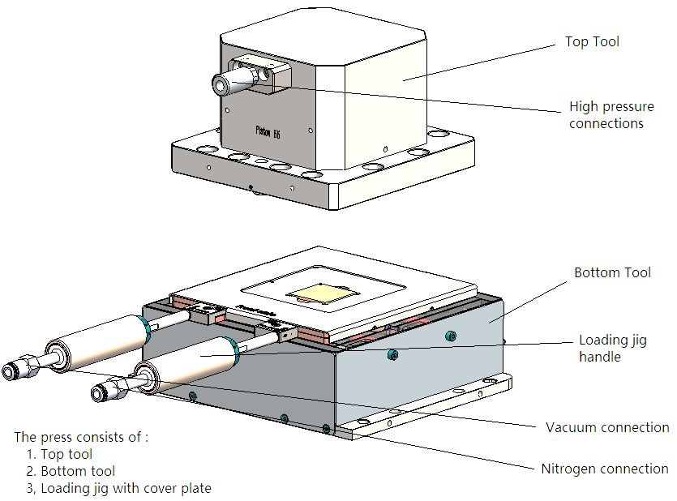
Sinterstar Mini
Universal Base Tool
a) The universal base tool designed for laboratory purposes with manual loading and unloading of products using jigs that support utilization of a protective atmosphere.
b) The tool and its jigs are designed with flexibility in mind. Using alignment mask nitrogen and/or other accessories inside the jig, various products with various dimensions can be loaded and sintered.
c) The jigs can be closed using PTFE film to create a closed environment through which nitrogen can be flushed to prevent product oxidation.

Slide 8
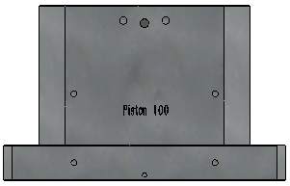
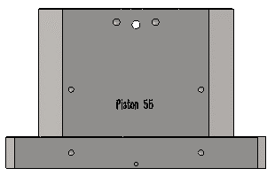
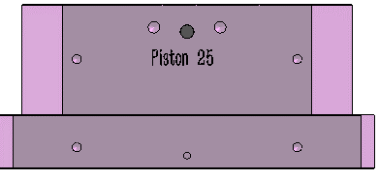
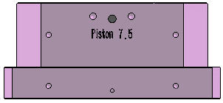
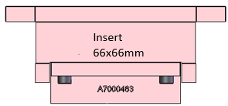
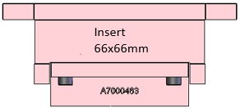
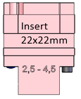
Sinterstar Mini
Universal Base Tool
Dynamic insert Units are separately available: 66x66mm(standard), 22x22mm(option),
Pistons are separately available 55(standard), 100mm,25mm ,7.5mm (options),
For different product request, Dynamic insert and pistons are easy and fast exchangeable
Option(100 piston)
Standard (55 piston)
Option(25 piston)
Option(7.5 piston)

Slide 9
Sinterstar Mini
Universal Base Tool
Universal top tool and top tool with 1 dynamic and 1 insert, and the 55mm piston and 66x66mm insert in the system is the standard configuration, other pistons, for example, 100mm,25mm,7,5mm or other is set for the option parts, and the piston area and insert size can be select by the below suggest sinter area.
Piston area | Effective insert size | Pressure Range | Suggest sinter area | Remark
100mm | 66x66mm±0.1mm | 0-30Mpa | 200-1800mm² | Option
55mm | 66x66mm±0.1mm | 0-30Mpa | 50-550mm² | Standard
25mm | 22x22mm±0.1mm | 0-30Mpa | 10-110mm² | Option
7.5mm | 22x22mm±0.1mm | 0-30Mpa | 1.5-12mm² | Option

Slide 10
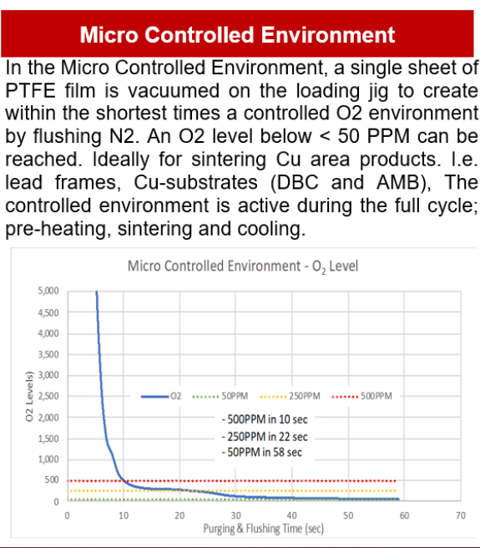
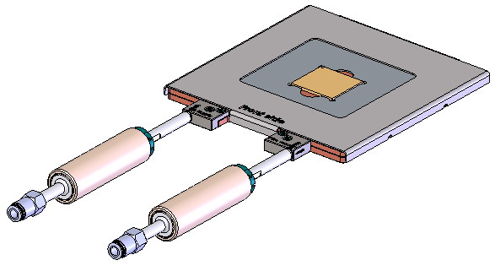
Sinterstar Mini
Loading jig
Cover plate
Loading jig
Handle
Nitrogen
Vacuum

Slide 11
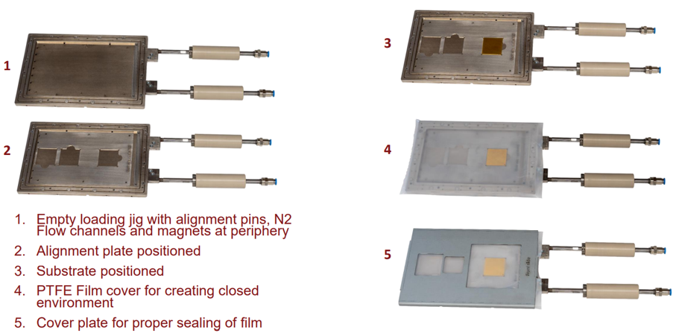
Sinterstar Mini
Loading jig
Example

Slide 12
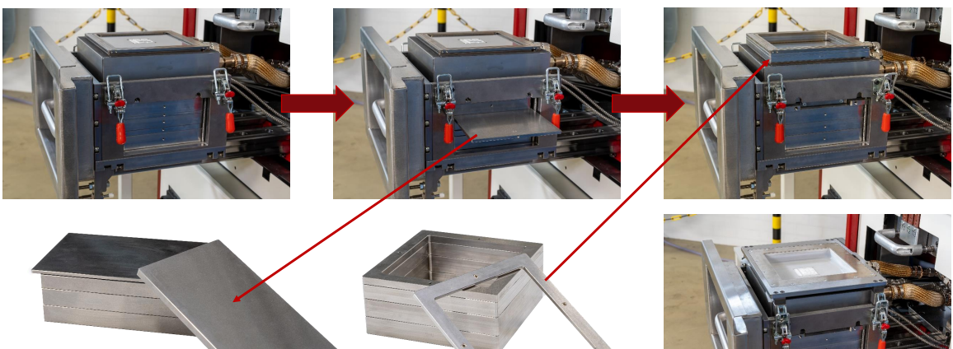
Sinterstar Mini
Product Height Conversion
The height of product can reach about 70mm

Slide 13
Sinterstar Mini
Process sequence
1. Open drawer and place product
1. Remove the drawer cover.
2. If required, adjust the heating plate for the product height.
3. Load the product. Positioning mask plates can be used.
4. Apply film and install the drawer cover
2. Close the drawer (System operates automatically until step 7)
3. Preheat the product (according to use the Preheat unit option or not)
4. Sintering: Lower the insert onto the product and apply dynamic insert pressure, while further heating up
5. After cycle: Release pressure, lift the insert from the product
6. Cool the product (according to use the Cooling unit option or not)
7. Open the drawer and remove/exchange product:
1. Remove the drawer cover
2. Remove the film
3. Remove the product

